Slide 1
Jhipster
Microservices

Slide 2
JHipster Registry
is a runtime application, provided by the JHipster team.
has three main purposes:
  Eureka server
  Spring Cloud Config server
  administration server, with dashboards to monitor and manage applications.

Slide 3
Prometheus
open-source systems monitoring and alerting toolkit originally built at SoundCloud.
https://prometheus.io/docs/introduction/overview/

Slide 4
Træfik
(pronounced like traffic) is a modern HTTP reverse proxy and load balancer made to deploy microservices with ease.

Slide 5
Netflix OSS
OSS = Open Source Software

Slide 6
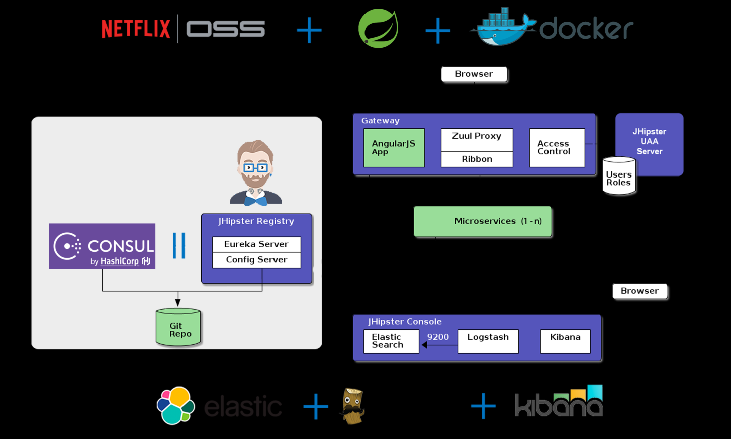

Slide 7
Yarn
A new package manager for JavaScript
https://code.facebook.com/posts/1840075619545360
Replacement for npm.
Facebook
https://github.com/yarnpkg/yarn
https://yarnpkg.com/en/docs/installYes

Slide 8
Boxfuse

Slide 9
IAM Policies
A policy is an entity in AWS that, when attached to an identity or resource, defines their permissions.
Policies are stored in AWS as JSON documents attached to principals as identity-basedpolicies, or to resources as resource-based policies.

Slide 10
Amazon
IAM - AWS Identity and Access Management (IAM) is a web service that helps you securely control access to AWS resources.
AMI - Amazon Machine Images (AMI)
https://www.ybrikman.com/writing/2015/11/11/running-docker-aws-ground-up/

Slide 11
JHipster Domain Language (JDL)
https://www.jhipster.tech/jdl/
describe all your entities and their relationships in a single file
you can generate entities from a JDL file using the import-jdlsub-generator, by running jhipster import-jdl your-jdl-file.jh

Slide 12
Travis CI

Slide 13
Chocolatey
Software Management Automation
https://www.slant.co/versus/6470/6471/~chocolatey_vs_scoop

Slide 14
Kubernetes
Kubernetes is an open-source system for automating deployment, scaling and management of containerized applications.
Desired State Management
Clustered Services API
Worker – Container Host
Kublet process communicates with CS API.
Desired State in deployment yml file.
  Pod configuration.

Slide 15
Kubernetes
in·gress - the action or fact of going in or entering.
Ingress traffic is network traffic that originates from outside of the network's routers and proceeds toward a destination inside of the network.
An Ingress Controller is a daemon, deployed as a Kubernetes Pod, that watches the apiserver's /ingresses endpoint for updates to the Ingress resource. Its job is to satisfy requests for Ingresses.

Slide 16
Kubernetes Ingress
Ingress gives you a way to route requests to services based on the request host or path, centralizing a number of services into a single entry point.
split up into two main pieces
  Ingress resource, which defines how you want requests routed to the backing services.
  Ingress Controller can technically be any system capable of reverse proxying, but the most common is Nginx.

Slide 17
Docker on AWS
To get Docker running on the AWS AMI:
Update the packages on your instance
  [ec2-user ~]$ sudo yum update -y
Install Docker
  [ec2-user ~]$ sudo yum install docker -y
Start the Docker Service
  [ec2-user ~]$ sudo service docker start
Add the ec2-user to the docker group so you can execute Docker commands without using sudo.
  [ec2-user ~]$ sudo usermod -a -G docker ec2-user

Slide 18
Docker References
https://serverfault.com/questions/836198/how-to-install-docker-on-aws-ec2-instance-with-ami-ce-ee-update

Slide 19
Install Java 8 on AWS AMI
sudo yum install java-1.8.0
sudo yum remove java-1.7.0-openjdk

Slide 20
Java References
https://serverfault.com/questions/664643/how-can-i-upgrade-to-java-1-8-on-an-amazon-linux-server

Slide 21
https://stackoverflow.com/questions/29117570/orchestrating-microservices

Slide 22
Apache Cassandra
NoSQL database

Slide 23
JSR 374 Specification
Java API for JSON Processing
e.g. parse, generate, transform and query) JSON messages.

Slide 24
CQRS
CQRS stands for Command Query Responsibility Segregation.

Slide 25
Object-functional programming
https://blog.codecentric.de/en/2015/08/essence-of-object-functional-programming-practical-potential-of-scala/

Slide 26
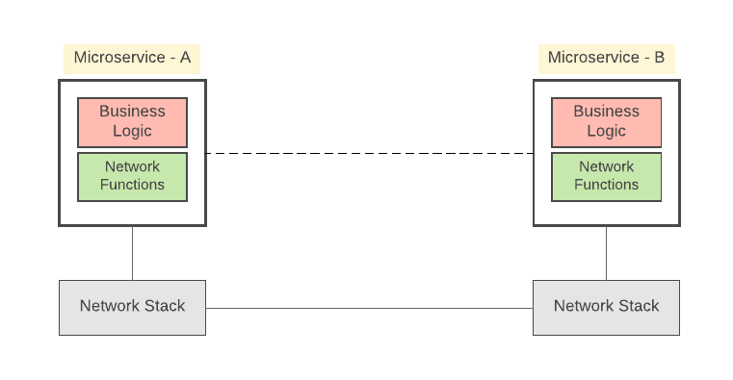
Microservices
The most complex challenge in realizing microservice architecture is not building the services themselves, but the communication between services.

Slide 27
Service Mesh
inter-service communication requirements are quite generic across all microservices implementations.
think about offloading all such tasks to a different layer, so that we can keep the service code independent.
That’s where ‘service mesh’ comes into the picture.

Slide 28
Service Mesh
A Service Mesh is an inter-service communication infrastructure.
  A given Microservice won’t directly communicate with the other microservices.
  all service-to-service communications will take places on-top of a software component called service mesh (or side-car proxy).
  A Service-mesh is language agnostic
  standard protocols such as HTTP1.x/2.x, gRPC etc.

Slide 29
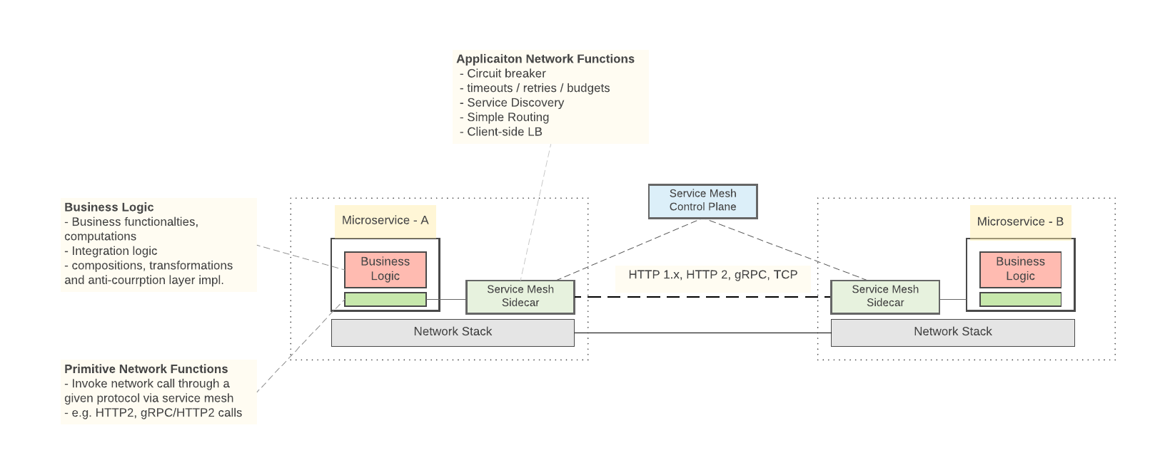
Service Mesh

Slide 30
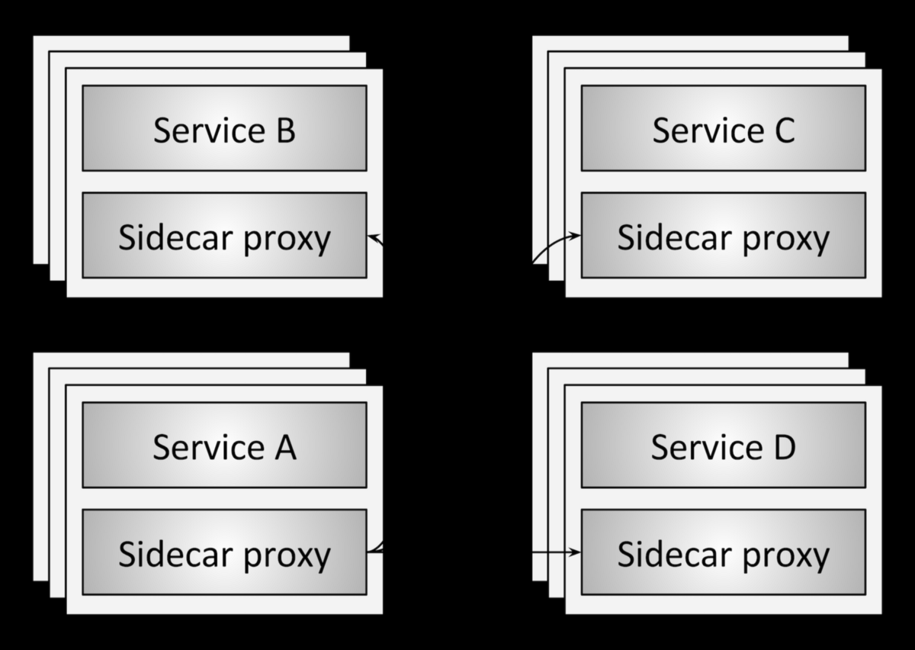
Service Mesh

Slide 31
Service Mesh
Control Plane
  Makes decisions about where traffic is sent
  Control plane packets are destined to or locally originated by the router itself
  The control plane takes a set of isolated stateless sidecar proxies and turns them into a distributed system.
Data Plane
  the sidecar proxy is the data plane
  Said another way, the data plane is responsible for conditionally translating, forwarding, and observing every network packet that flows to and from a service instance.

Slide 32
Service Mesh
Data plane vs. control plane summary
  Service mesh data plane
    Touches every packet/request in the system. Responsible for service discovery, health checking, routing, load balancing, authentication/authorization, and observability.
  Service mesh control plane
    Provides policy and configuration for all of the running data planes in the mesh. Does not touch any packets/requests in the system. The control plane turns all of the data planes into a distributed system.

Slide 33
Internet Layers
L7 - Application
  L7 - Application
  L6 - Presentation
L4 - Transport
  L5 - Session
  L4 - Transport
L3 - Network
L2 – Link and L1 – Physical
http://www.cs.unh.edu/~rbartos/class/cs725/ay/notes/cs725-spring-2014-03.pdf

Slide 34
Microservices Architectural Patterns
Service mesh
  Side Car Proxy
Deploys
  deploys accomplished using blue/green
  canary

